Slide 1
Building the Framework with EDK I
Intel Corporation
Software and Services Group

Slide 2
Agenda
  Terms
  Framework Release code base tree structure
  Framework Release build infrastructure
  Framework Release related tools
  Build failure cases examples

Slide 3
Terms
  DSC file .dsc files describe the build rules, libraries and components.
  ENV file .env files describe the build tools and configurations.
  INF file .inf file describes one library or component.
  PKG file .pkg file describes the layout of sections to construct FFS.
  FFS file Firmware File System file (.ffs).
  FV file Firmware Volume image file (.fv).
  FDF file Flash device region description file. (.fdf)

Slide 4
The EDK Directory Tree
EDK
  Foundation
    Core
    CPU
    EFI
    Framework
    GUID
    Include
    Library
    Ppi
    Protocol
  Sample
    Bus
    Chipset
    CPU
    Include
    Library
    Platform
    Tools
    Universal
  Other
    Maintained
    Non-Maintained
The EDK directory contains all of the source necessary to build the NT32 platform tip. This is the open source project that is located at TianoCore.Org. This directory does not include all of the Framework source.
  The EDK subdirectories follow the same hierarchy of the Framework Subdirectories.

Slide 5
Framework Release code base tree structure (EDK)
  EDK is the core of Framework Release Package
  Edk\
    Open source EDK project
  Edk\Foundation
    All UEFI, PI and Framework definitions in Efi, Framework directory.
    Core drivers and libraries, such as DxeCore.
  Edk\Sample
    Sample Tools, Driver and Platform: Nt32 and Duet
  Edk\Other
    Other projects or third party code

Slide 6
The Framework Directory Tree
Framework
  Application
  Bus
  Chipset
  CPU
  CSM
  GUID
  Include
  Library
  Platform
  Ppi
  Protocol
  Tools
  Universal
The Framework directory contains all of the source (foundation, drivers, chipset, CPU, etc…) necessary to build all platforms with working Framework Tips.

Slide 7
Framework Release code base tree structure
(Others)
  Application\
    Uefi Application, such as shell commands
  Bus\
    None open source bus drivers, such as PcCard
  Chipset\
    Different chipset codes, such as Ich, Smsc
  Core\
    IPF PAL binary file for the different processors.
  Cpu\
    Cpu Code for Itanium, Pentium and WinNtThunk
  Csm\
    Csm Thunk Driver

Slide 8
Framework Release code base tree structure
(Others-Cont.)
  Guid\
    Guid definitions used in code base, not defined in specs
  Include\
    IndustryStandard definitions for the different ACPI tables
  Library\
    Framework library implementation
  Platform\
    Driver, library and definitions close to platform, and platform.dsc
  Ppi\
    Ppi definitions used in code base, not defined in specs
  Protocol\
    Protocol definitions used in code base, not defined in specs
  Tools\
    Build tools to create the image that runs in real platform.
  Universal\
    Drivers irrelevant to platform, such as Network, Security and FileSystem

Slide 9
Agenda
  Terms
  Framework Release code base tree structure
  Framework Release build infrastructure
  Framework Release related tools
  Build failure cases examples
  Q/A

Slide 10
Build Process
Build Tools
Tools
FlashMap
Source
Build Flash
Map
Flash Map
Flash
Image
FV
Platform
Description
Build
…
Build
Settings
FV
ProcessDSC
MakeFiles
KEY
Green – Process
Yellow – Source or Inputs
Grey – Output or Intermediate
Blue – Final ROM image
Build Outputs
FV/OBJ/LIB
Build
Settings

Slide 11
Framework Release build infrastructure
(Main Build Flow)
  The Framework Firmware image is built in following sequence
  Build Tools
    Call each tool makefile to build the tool binaries.
  Build Flashmap
    Use FlashMap tool to generate FlashMap.dsc, FlashMap.h and FlashMap.inc.
  Build Makefiles
    Master Makefile in .\Edk\Sample\Platform\$(PROJECT_NAME)\Build directory
    Use ProcessDsc tool to generate makefile.out, all module makefiles and create all build directories.
  Build Builds
    Call the generated makefile.out and all module makefiles to build libraries, components and FVs.
  Build FDs
    Use FlashMap tool to generate the final flash image

Slide 12
Framework Release build infrastructure
(Build File)
  Build description files
    Platform DSC, module INF and platform FDF file
  Build configuration files
    Common DSC, Common$(PROCESSOR) DSC
    Config.env, PlatformTools.env, LocalTools.env, Version.env

Slide 13
Framework Release build infrastructure
(DSC)
Platform description file (DSC)
    Master DSC file for one platform
    Defines the platform specific build rules
    Contains all modules used in this platform
Create the following output files:
    A makefile for each module
    A main makefile.out that calls nmake for each module’s makefile
    One or more firmware volume .INF files that are used by the GenFvImage utility to build the desired firmware volumes
For example Nt32 platform DSC:
$(EDK_SOURCE)\Sample\Platform\Nt32\Build\Nt32.dsc

Slide 14
Framework Release build infrastructure
(DSC)
Section | Description
Defines | Section defining any symbols that may be used in .DSC file
Fv build | Sections describing how to build firmware volumes, some firmware volumes needs to be rebased.
Fv Options | Sections describing firmware volume options, like fv name, size.
Fv Attributes | Sections describing firmware volume attributes, like its alignment.
Package | Sections describing the specific platform package layout for component, like AcpiTable.
Libraries | Sections including a list of common and platform specific library description files with their path relative to EFI_SOURCE
Components | Sections including a list of all the executable component description files, like drivers, applications, DxeCore and etc.

Slide 15
Framework Release build infrastructure
(DSC)
DSC files Relationship
$(PROJECT_NAME).dsc
    The master DSC file for one platform, which defines the platform specific build rules and contains all modules used in this platform besides common and processor DSC files.
Common.dsc
    Common DSC file which defines the build rules for all kinds of source files and the different type modules.
Common$(PROCESSOR).dsc
    One processor specific DSC file, which mainly defines the special packages (.PKG) for the different processors.

Slide 16
Framework Release build infrastructure
(DSC)
.\Edk\Sample\Platform\$(PROJECT_NAME)\Build\$(PROJECT_NAME).dsc
.\Edk\Sample\Platform\Common.dsc
.\Edk\Sample\Platform\Common$(PROCESSOR).dsc
.\Edk\Sample\Platform\EdkLibAll.dsc

Slide 17
Framework Release build infrastructure
(INF)
Module description file (INF)
    Defines the source files, libraries, and definitions relevant to building the component
    Contained in Platform DSC file
    ProcessDsc tool read DSC file to generate makefile for INF
  .INF file generally includes the following sections

Slide 18
Framework Release build infrastructure
(INF)
  .INF file generally includes the following sections
Section | Description
Defines | Required. Section defining any symbols that may be used in the .INF file, like BASE_NAME, FILE_GUID, COMPONENT_TYPE.
Sources | Optional. Sections including a list of .c and other types of source files with their paths relative to that of the .INF file
Includes | Optional. Sections including a list of inclusion directories
Libraries | Optional. Sections including a list of libraries depended by the module
Nmake | Optional. Sections including a list of parameters for compilers, like IMAGE_ENTRY_POINT and DPX_SOURCE

Slide 19
Flash description File (FDF)
Flash description file (INF) describes flash device definitions and defines the contents of the regions in flash.
.fdf file generally includes the following sections.
Section | Description
FlashDevice | Defines Name, Size, Block and Region, Subregion.
FlashDeviceImage | Describe the contents in each flash region, sub region.

Slide 20
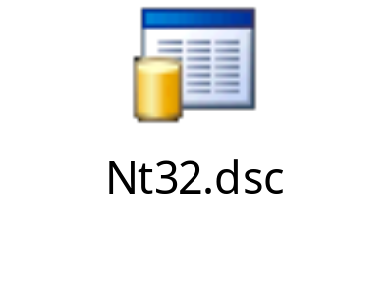
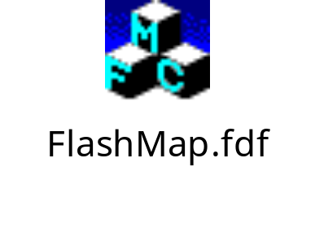
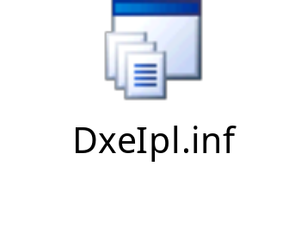

Example files
Platform Dsc file example Flash Description File (Fdf)
Module INF file example
See Back Up

Slide 21
Framework Release build infrastructure
(Env)
ENV files can be regarded as part of makefile. Both master makefile and module makefiles include them.
PlatformTools.env
    Framework build tip platform configurations which will be included by master makefile and all the module makefiles
Config.env
    Defines build configuration flags for Framework build tip
CommonTools.env
    Defines common tools configurations and build options for Framework build tip
LocalTools.env
    Defines local tools default path for Framework build tip
Version.env
    Defines Framework build version

Slide 22
Framework Release build infrastructure
(Env)
Edk PlatformTools ENV File relationship
.\Edk\Sample\Platform\$(PROJECT_NAME)\Build\PlatformTools.env
.\Edk\Sample\Platform\$(PROJECT_NAME)\Build\Config.env
.\Edk\Sample\CommonTools.env
.\Edk\Sample\LocalTools.env
.\Edk\Sample\Version.env

Slide 23
Agenda
  Terms
  Framework Release code base tree structure
  Framework Release build infrastructure
  Framework Release related tools
  Build failure cases examples
  Q/A

Slide 24
Framework Release related tools
(Build Script)
Build.bat script in \Edk\Sample\Platform\$(PROJECT_NAME)\ provides build, clean and find module functions.
Help
  Build /? to print help information
  Build /h to print help information

Slide 25
Framework Release related tools
(Build Script)
    Build
      Build single module with input base name, such as build DxeMain.
      If /r option is specified, the module will be cleaned first and rebuilt.
      If no input module, then build all
      Other, there are three special build targets: all, fast, tools.
      Build - build all tools and modules.
      Build all - build all tools and modules.
      Build fast - build all without FV=NULL modules.
      Build tools - only build all tools.
      For example:
        C:\> build #Build the whole tip
        C:\> build DxeMain #Single build DxeMain module
        C:\> build /r DxeMain #Clean DxeMain module, then build it.
        C:\> build tools #Build all tools

Slide 26
Framework Release related tools
(Build Script)
    Clean
      Remove the build output files of single module with input module name.
      If no input module, then clean all build directories.
      Other, there are three special clean targets: all, modules, tools.
      Build /c - clean up all build directories.
      Build /c all - clean up all build directories and binary directory.
      Build /c modules - clean up all build directories except for tools.
      Build /c tools - clean up only tools directory.
      For example:
        C:\> build /c #Remove all build directories.
        C:\> build /c DxeMain #Remove the built files only for Dxemain
        C:\> build /c modules #Remove all build directories except for tools.

Slide 27
Framework Release related tools
(Build Script)
  Find
    This function searches all matched module name with input substring of module name. If no input, all module names will output.
    If /v option is specified, the module name will output together with the complete inf file path.
    If /a option is specified, platform dsc file will be re-processed to update module list information. When you modify dsc file or inf file, you can use /a option to refresh all module name list in current build tip.
    For example:
      C:\> build /f pei #find all module name with “pei” string
        PeiMain
        PeiFlashMap
        PeiVariable
      C:\> build /f /v pei #find all module name with “pei” in verbos mode
        PeiMain K:\R8\Edk\Foundation\Core\Pei\PeiMain.inf
        PeiFlashMap K:\R8\Edk\Sample\Platform\Nt32\Pei\FlashMap\FlashMap.inf
        PeiVariable K:\R8\Edk\Sample\Universal\Variable\Pei\Variable.inf

Slide 28
Framework Release related tools
(Build Tools)
The build tools’ source is under .\Edk\Sample\Tools\Source and .\Tools.
ProcessDsc.exe:
Parse all the DSC/INF files to generate makefile.out, all module makefiles and create all build directories.
FlashMap.exe:
Parse FDF file to create the final platform flash image (FD). It can also parse microcode.txt file.
FwImage.exe:
Process PE32 image to EFI image with efi subsystem
GenTEImage.exe:
Process EFI image to TE image with the compact TE header according to PI1.0 spec.
GenAprioriFile.exe:
Create AprioriFile FFS that contains the dispatch order
GenSection.exe:
Attach the EFI section header to the input file.
GenFfsFile.exe:
Combine a group of EFI section files into a single FFS file.

Slide 29
Framework Release related tools
- Continue
GenFvImage.exe:
Aggregate a collection of FFS files into a single FV image.
GenCapsuleHdr.exe:
Add capsule header to the input capsule volume.
PeiRebase.exe:
Rebase all addresses of the PE image in FFS file based on its offset to Fv Image header.
StrGather.exe:
Process unicode strings file to create a .h and .c file.
VfrCompiler.exe:
Process VFR source file to create one source C file.
GenDepex.exe:
Parse a text EFI dependency expression file and convert the data into a raw binary representation.
EfiCompress:
Compress data using EFI standard compression or Tiano extension Compression.
EfiRom:
Create an option ROM image from a list of input files.

Slide 30
Agenda
  Terms
  Framework Release code base tree structure
  Framework Release build infrastructure
  Framework Release related tools
  Build failure cases examples
  Q/A

Slide 31
Build Failure cases examples
ProcessDsc: Duplicate section found (Package)
ProcessDsc: Duplicate base name specified
ProcessDsc: Duplicate Guid specified in the same FV
GenFvImage: Insufficient space remains to add the file

Slide 32
ProcessDSC:
Duplicate section found (Package)
Cause:
Duplicate section like Package section is found both in Common$(PROCESSOR).dsc and $(PROJECT).dsc file.
Solution:
Delete the duplicated section in $(PROJECT).dsc file, because all the common package definitions have been added to Common$(PROCESSOR).dsc.

Slide 33
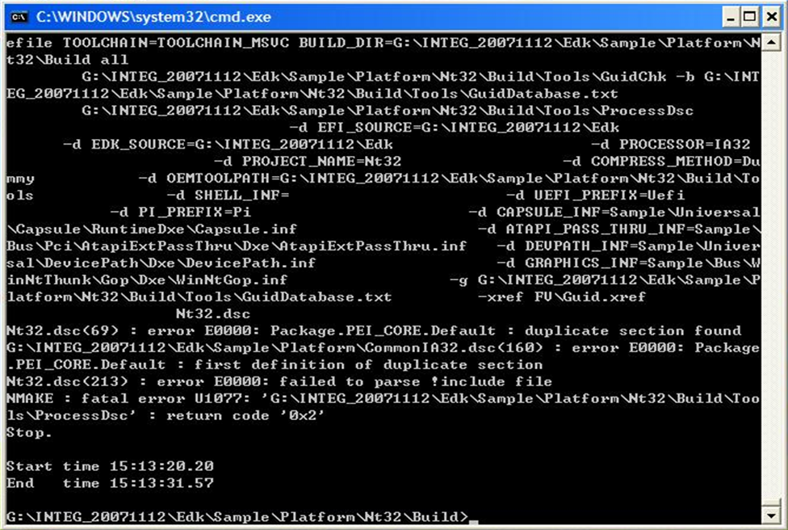

Slide 34
ProcessDSC:
Duplicate base name specified
Cause:
ProcessDsc detected duplicate base name FFS files with the same build processor type.
Solution:
Remove the duplicate base name FFS file.
Change the duplicate base name in another module inf file.

Slide 35
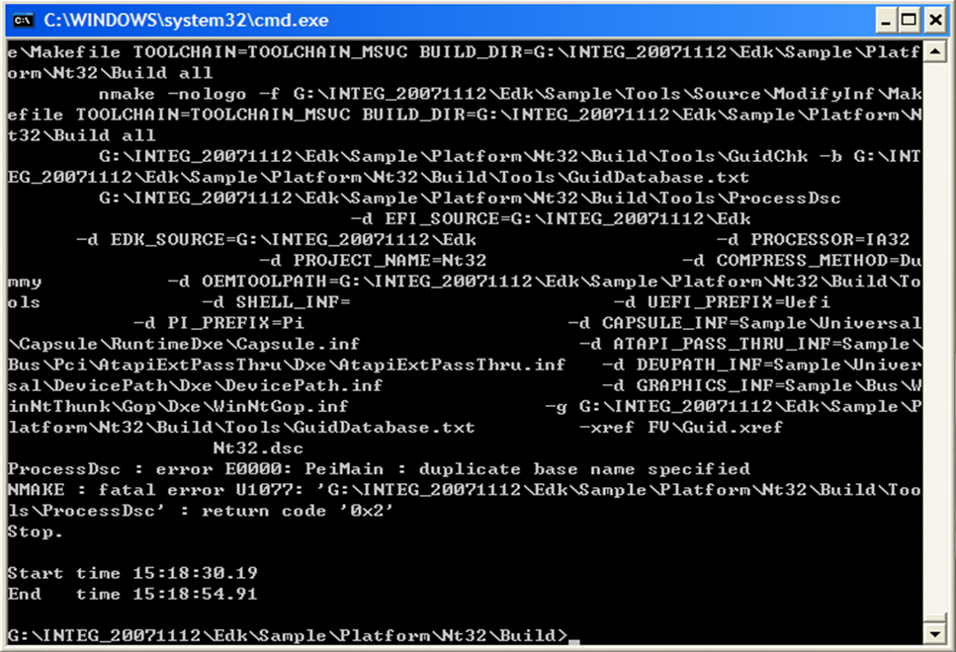

Slide 36
ProcessDSC:
Duplicate Guid specified in the same FV
Cause:
ProcessDsc detected duplicate FFS file Guid in the same FV
Solution:
Remove the duplicate Guid FFS file.
Change the duplicate Guid FFS file to another FV.
Change the duplicate Guid: change FILE_GUID in module inf file.

Slide 37
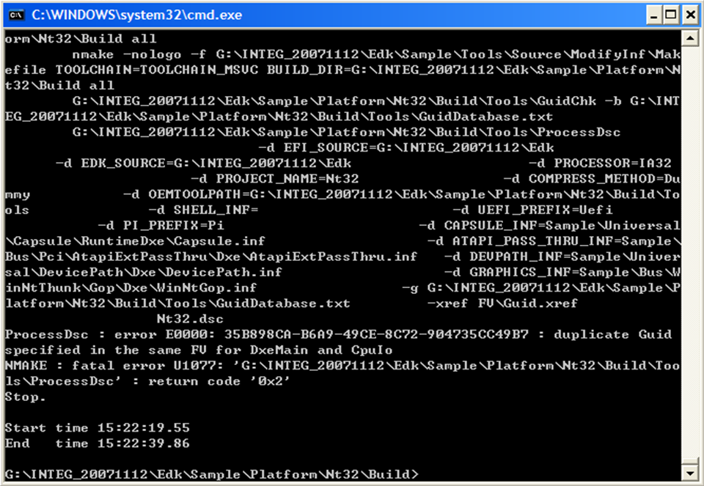

Slide 38
GenFvImage:
Insufficient space remains to add the file
Cause:
GenFvImage failed to generate this FV when adding the following FFS files because the space left in this FV is insufficient to include these FFS files.
Solution:
Increase this FV size by extending its EFI_NUM_BLOCKS option.
Remove some FFS files or reduce the FFS file size.

Slide 39
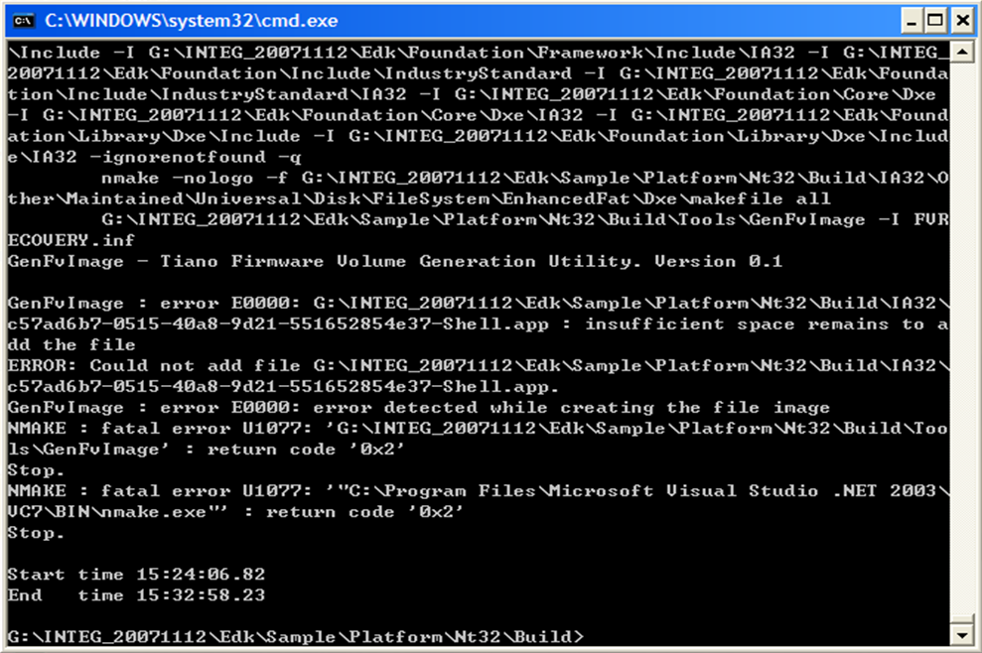

Slide 40




Q & A

Slide 41


Slide 42
Back up
Back Up

Slide 43
Nt32.Dsc file
[Defines]
PLATFORM = $(PROJECT_NAME)
FV_RECOVERY_BASE_ADDRESS = 0xFFD80000
NV_STORAGE_BASE_ADDRESS = 0xFFFC0000
# Actual variable block size should exclude the size of the FV header.
EFI_NV_VARIABLE_STORE_LENGTH = 0xC000
EFI_NV_EVENT_LOG_LENGTH = 0x2000
EFI_NV_FTW_WORKING_LENGTH = 0x2000
EFI_NV_FTW_SPARE_LENGTH = 0x10000
# Include other common build descriptions
#
!include "$(EDK_SOURCE)\Sample\Platform\Common.dsc"
!include "$(EDK_SOURCE)\Sample\Platform\Common$(PROCESSOR).dsc"
# Commands to build firmware volumes using the FV INF file
Fv\$(FV_FILENAME).fv : Fv\$(FV_FILENAME).inf $($(FV_FILENAME)_FILES)
@cd Fv
$(GENFVIMAGE) -I $(FV_FILENAME).inf
@cd ..
# These control the generation of the FV files
#
[Fv.FvRecovery.Options]
EFI_BASE_ADDRESS = $(FV_RECOVERY_BASE_ADDRESS)
EFI_FILE_NAME = FvRecovery.fv
EFI_NUM_BLOCKS = 0x28
EFI_BLOCK_SIZE = 0x10000
[Fv.FvFile.Options]
EFI_BASE_ADDRESS = 0x00000000
EFI_FILE_NAME = $(FV_FILENAME).fv
EFI_NUM_BLOCKS = 0x2
EFI_BLOCK_SIZE = 0x10000
[Fv.NvStorage.Options]
EFI_BASE_ADDRESS = $(NV_STORAGE_BASE_ADDRESS)
EFI_FILE_NAME = $(FV_FILENAME).fv
EFI_NUM_BLOCKS = 0x2
EFI_BLOCK_SIZE = 0x10000
EFI_FV_GUID = fff12b8d-7696-4c8b-a985-2747075b4f50
[Fv.NvStorage.Components]
EFI_NV_VARIABLE = $(EFI_NV_VARIABLE_STORE_LENGTH)
EFI_NV_EVENT_LOG = $(EFI_NV_EVENT_LOG_LENGTH)
EFI_NV_FTW_WORKING = $(EFI_NV_FTW_WORKING_LENGTH)
EFI_NV_FTW_SPARE = $(EFI_NV_FTW_SPARE_LENGTH)
[Fv.FvRecovery.Attributes,Fv.FvFile.Attributes,Fv.NvStorage.Attributes]
EFI_READ_DISABLED_CAP = TRUE
EFI_READ_ENABLED_CAP = TRUE
EFI_READ_STATUS = TRUE
EFI_WRITE_DISABLED_CAP = TRUE
EFI_WRITE_ENABLED_CAP = TRUE
EFI_WRITE_STATUS = TRUE
EFI_LOCK_CAP = TRUE
EFI_LOCK_STATUS = TRUE
EFI_STICKY_WRITE = FALSE
EFI_MEMORY_MAPPED = TRUE
EFI_ERASE_POLARITY = 1
EFI_ALIGNMENT_CAP = TRUE
EFI_ALIGNMENT_2 = TRUE
EFI_ALIGNMENT_4 = TRUE
EFI_ALIGNMENT_8 = TRUE
EFI_ALIGNMENT_16 = TRUE
EFI_ALIGNMENT_32 = TRUE
EFI_ALIGNMENT_64 = TRUE
EFI_ALIGNMENT_128 = TRUE
EFI_ALIGNMENT_256 = TRUE
EFI_ALIGNMENT_512 = TRUE
EFI_ALIGNMENT_1K = TRUE
EFI_ALIGNMENT_2K = TRUE
EFI_ALIGNMENT_4K = TRUE
EFI_ALIGNMENT_8K = TRUE
EFI_ALIGNMENT_16K = TRUE
EFI_ALIGNMENT_32K = TRUE
EFI_ALIGNMENT_64K = TRUE
#
#New Attribute for PI 1.0 spec
#
EFI_READ_LOCK_CAP = TRUE
EFI_READ_LOCK_STATUS = TRUE
EFI_WRITE_LOCK_CAP = TRUE
EFI_WRITE_LOCK_STATUS = TRUE
EFI_FVB2_ALIGNMENT = 8

Slide 44
Nt32.Dsc file
Continued
# These are the libraries that will be built by the master makefile
[Libraries]
DEFINE EDK_PREFIX=
!include "$(EDK_SOURCE)\Sample\Platform\EdkLibAll.dsc"
# EdkII Glue Library
#!include "$(EDK_SOURCE)\Sample\Platform\EdkIIGlueLibAll.dsc"
# These are platform specific libraries that must be built prior to building
# certain drivers that depend upon them.
[Libraries.Platform]
Sample\Platform\Nt32\Ppi\EdkNt32PpiLib.inf
Sample\Platform\Nt32\Protocol\EdkNt32ProtocolLib.inf
Sample\Cpu\WinNtThunk\Sec\SecMain.inf
Sample\Library\Dxe\WinNt\WinNtLib.inf
Sample\Platform\Generic\MonoStatusCode\Library\Pei\MemoryStatusCode\MemoryStatusCode.inf
Sample\Platform\Generic\RuntimeDxe\StatusCode\Lib\BsDataHubStatusCode\BsDataHubStatusCode.inf
Sample\Platform\Generic\RuntimeDxe\StatusCode\Lib\RtMemoryStatusCode\RtMemoryStatusCode.inf
Sample\Platform\Generic\RuntimeDxe\StatusCode\Lib\RtPlatformStatusCode\
$(PROJECT_NAME)\RtPlatformStatusCode.inf
Sample\Platform\Generic\Dxe\GenericBds\GenericBds.inf
Sample\Bus\Usb\UsbLib\Dxe\UsbDxeLib.inf
#Sample\Bus\Scsi\ScsiLib\Dxe\ScsiLib.inf
Sample\Universal\Network\Library\NetLib.inf
Other\Maintained\Application\Shell\Library\EfiShellLib.inf
[Components]
#
# The default package
#
DEFINE PACKAGE=Default
#
# By default components in this section belong in the recovery FV.
# This FV primarily contains PEI code.
#
DEFINE FV=FvRecovery
[Capsule.Capsule_A.Options]
EFI_BASE_ADDRESS = $(FV_RECOVERY_BASE_ADDRESS)
EFI_FILE_NAME = Capsule_A.fv
EFI_NUM_BLOCKS = 0x28
EFI_BLOCK_SIZE = 0x10000
[Capsule.Capsule_A.Attributes]
EFI_READ_DISABLED_CAP = TRUE
EFI_READ_ENABLED_CAP = TRUE
EFI_READ_STATUS = TRUE
EFI_WRITE_DISABLED_CAP = TRUE
EFI_WRITE_ENABLED_CAP = TRUE
EFI_WRITE_STATUS = TRUE
EFI_LOCK_CAP = TRUE
EFI_LOCK_STATUS = TRUE
EFI_STICKY_WRITE = FALSE
EFI_MEMORY_MAPPED = TRUE
EFI_ERASE_POLARITY = 1
EFI_ALIGNMENT_CAP = TRUE
EFI_ALIGNMENT_2 = TRUE
EFI_ALIGNMENT_4 = TRUE
EFI_ALIGNMENT_8 = TRUE
EFI_ALIGNMENT_16 = TRUE
EFI_ALIGNMENT_32 = TRUE
EFI_ALIGNMENT_64 = TRUE
EFI_ALIGNMENT_128 = TRUE
EFI_ALIGNMENT_256 = TRUE
EFI_ALIGNMENT_512 = TRUE
EFI_ALIGNMENT_1K = TRUE
EFI_ALIGNMENT_2K = TRUE
EFI_ALIGNMENT_4K = TRUE
EFI_ALIGNMENT_8K = TRUE
EFI_ALIGNMENT_16K = TRUE
EFI_ALIGNMENT_32K = TRUE
EFI_ALIGNMENT_64K = TRUE

Slide 45
Nt32.Dsc file
Continued
# SEC Core
# SEC core is a separate utility built by the makefile.
#
# PEI Core
#
Foundation\Core\$(PI_PREFIX)Pei\PeiMain.inf
# PEIM
# APRIORI list, this is a list of drivers run without dependencies
#
Sample\Universal\FirmwareVolume\Apriori\Pei\AprioriList.inf FV=FvRecovery
Sample\Platform\Generic\MonoStatusCode\Pei\$(PROJECT_NAME)\
MonoStatusCode.inf APRIORI=FvRecovery:1
Sample\Platform\Nt32\Pei\BootMode\BootMode.inf APRIORI=FvRecovery:2
Sample\Platform\Nt32\Pei\FlashMap\FlashMap.inf
Sample\Universal\GenericMemoryTest\Pei\BaseMemoryTest.inf
Sample\Universal\Variable\Pei\Variable.inf
Sample\Platform\Nt32\Pei\Autoscan\WinNtAutoScan.inf
Sample\Platform\Nt32\Pei\FirmwareVolume\WinNtFwh.inf
Sample\Universal\DxeIpl\Pei\DxeIpl.inf
Sample\Platform\Nt32\Pei\WinNtStuff\WinNtStuff.inf
# DXE Core
#
Foundation\Core\Dxe\DxeMain.inf PACKAGE=DxeMain
#
# Guided Section Extraction Protocol used to authenticate images
#
Sample\Universal\FirmwareVolume\GuidedSectionExtraction\
Crc32SectionExtract\Dxe\Crc32SectionExtract.inf
# Components that produce the architectural protocols
#
Sample\Cpu\WinNtThunk\CpuIo\Dxe\CpuIo.inf
Sample\Cpu\WinNtThunk\Cpu\Dxe\Cpu.inf
Sample\Chipset\WinNtThunk\Metronome\Dxe\Metronome.inf
Sample\Chipset\WinNtThunk\Timer\Dxe\Timer.inf
Sample\Universal\WatchdogTimer\Dxe\WatchDogTimer.inf
Sample\Chipset\WinNtThunk\RealTimeClock\RuntimeDxe\RealTimeClock.inf
Sample\Chipset\WinNtThunk\Reset\RuntimeDxe\Reset.inf
Sample\Universal\Runtime\Dxe\Runtime.inf
Sample\Universal\MonotonicCounter\RuntimeDxe\MonotonicCounter.inf
Sample\Platform\Generic\RuntimeDxe\StatusCode\StatusCode.inf
Sample\Platform\Generic\RuntimeDxe\FvbServices\nt32fwh.inf
Sample\Universal\FirmwareVolume\FaultTolerantWriteLite\Dxe\FtwLite.inf
Sample\Universal\Variable\RuntimeDxe\Variable.inf
Sample\Platform\Nt32\Dxe\PlatformBds\PlatformBds.inf
Sample\Universal\Security\SecurityStub\Dxe\SecurityStub.inf
$(CAPSULE_INF)
#
# Drivers necessary to use the debugger
# These are placed here so they will load early if they are desired.
# NOTE:
# Including these in the FV will take over use of the COM port.
#
Sample\Universal\Debugger\Debugport\Dxe\DebugPort.inf FV=NULL
Sample\Cpu\DebugSupport\Dxe\DebugSupport.inf FV=NULL
#
# Following are the DXE drivers (alphabetical order)
#
Sample\Platform\Generic\Dxe\ConPlatform\ConPlatform.inf
Sample\Universal\Console\ConSplitter\Dxe\ConSplitter.inf
Sample\Universal\Console\GraphicsConsole\Dxe\GraphicsConsole.inf
Sample\Universal\Console\Terminal\Dxe\Terminal.inf
Sample\Universal\DataHub\DataHub\Dxe\DataHub.inf
Sample\Universal\DataHub\DataHubStdErr\Dxe\DataHubStdErr.inf
$(DEVPATH_INF)
Sample\Universal\Disk\DiskIo\Dxe\DiskIo.inf
Sample\Universal\Ebc\Dxe\Ebc.inf
Sample\Universal\GenericMemoryTest\Dxe\NullMemoryTest.inf
Sample\Universal\UserInterface\$(UEFI_PREFIX)HiiDataBase\Dxe\HiiDatabase.inf
Sample\Platform\Generic\Logo\Logo.inf
Sample\Universal\Disk\Partition\Dxe\Partition.inf
Sample\Bus\Pci\PciBus\Dxe\PciBus.inf
Sample\Universal\UserInterface\$(UEFI_PREFIX)SetupBrowser\Dxe\SetupBrowser.inf
Sample\Universal\UserInterface\$(UEFI_PREFIX)SetupBrowser\Dxe\
DriverSample\DriverSample.inf
#Other\Maintained\Application\UefiShell\Bin\Shell.inf
other\Maintained\Application\Shell\Shellfull.inf
Other\Maintained\Application\Shell\CpuUtil\CpuUtil.inf FV=NULL
Sample\Universal\Disk\UnicodeCollation\English\Dxe\English.inf
Sample\Bus\WinNtThunk\BlockIo\Dxe\WinNtBlockIo.inf
Sample\Bus\WinNtThunk\Console\Dxe\WinNtConsole.inf
Sample\Bus\WinNtThunk\SerialIo\Dxe\WinNtSerialIo.inf
Sample\Bus\WinNtThunk\SimpleFileSystem\Dxe\WinNtSimpleFileSystem.inf
Sample\Bus\WinNtThunk\WinNtBusDriver\Dxe\WinNtBusDriver.inf
Sample\Bus\WinNtThunk\WinNtThunk\Dxe\WinNtThunk.inf

Slide 46
Nt32.Dsc file
Continued
# In EFI mode, GRAPHICS_INF = Sample\Bus\WinNtThunk\Uga\Dxe\WinNtUga.inf
# In UEFI mode, GRAPHICS_INF = Sample\Bus\WinNtThunk\Gop\Dxe\WinNtGop.inf
$(GRAPHICS_INF)
Sample\Platform\Nt32\Dxe\Nt32Platform\MiscSubclass\MiscSubclassDriver.inf
Sample\Bus\Pci\IdeBus\Dxe\idebus.inf
Sample\Bus\Pci\Uhci\Dxe\Uhci.inf
Sample\Bus\Pci\Undi\RuntimeDxe\Undi.inf
#$(ATAPI_PASS_THRU_INF)
#Sample\Bus\Scsi\ScsiBus\Dxe\ScsiBus.inf
#Sample\Bus\Scsi\ScsiDisk\Dxe\ScsiDisk.inf
Sample\Bus\Usb\UsbBus\Dxe\UsbBus.inf
Sample\Bus\Usb\UsbKb\Dxe\UsbKb.inf
Sample\Bus\Usb\UsbMassStorage\Dxe\UsbMassStorage.inf
Sample\Bus\Usb\UsbMouse\Dxe\UsbMouse.inf
#Sample\Universal\Network\PxeBc\Dxe\BC.inf
#Sample\Universal\Network\PxeDhcp4\Dxe\PxeDhcp4.inf
#Sample\Universal\Network\Snp32_64\Dxe\SNP.inf
#
# UEFI network drivers.
#
Sample\Universal\Network\Dpc\Dxe\Dpc.inf FV=NULL
Sample\Universal\Network\Mnp\Dxe\Mnp.inf FV=NULL
Sample\Universal\Network\Arp\Dxe\Arp.inf FV=NULL
Sample\Universal\Network\Ip4\Dxe\Ip4.inf FV=NULL
Sample\Universal\Network\Ip4Config\Dxe\Ip4Config.inf FV=NULL
Sample\Universal\Network\Udp4\Dxe\Udp4.inf FV=NULL
Sample\Universal\Network\Tcp4\Dxe\Tcp4.inf FV=NULL
Sample\Universal\Network\Dhcp4\Dxe\Dhcp4.inf FV=NULL
Sample\Universal\Network\Mtftp4\Dxe\Mtftp4.inf FV=NULL
Sample\Universal\Network\UefiPxeBc\Dxe\UefiPxeBc.inf FV=NULL
Sample\Universal\Network\IScsi\Dxe\$(UEFI_PREFIX)IScsi.inf FV=NULL
Sample\Universal\Network\SnpNt32\Dxe\SnpNt32.inf FV=NULL
#
# The following components are commented out for a variety of reasons.
# Components are listed in alphabetical order.
#
#
# Fat File System driver. Default is binary only
#
Other\Maintained\Universal\Disk\FileSystem\EnhancedFat\Dxe\Fat.inf
#other\Maintained\Application\Customize\CPUutil\CPUutil.inf FV=NULL
#
# Just define the working FV for the working block.
# This FV primarily contains private data of FTW and runtime updatable
# data such as variable and event log. It does not contain any FFS file
#
DEFINE NONFFS_FV=NvStorage

Slide 47
Example DxeIpl.inf
/* # Component description file for DxeIpl module
#
#--*/
[defines]
BASE_NAME = DxeIpl
FILE_GUID = 86D70125-BAA3-4296-A62F-602BEBBB9081
COMPONENT_TYPE = PE32_PEIM
[sources.common]
$(PI_PREFIX)DxeLoad.c
[sources.ia32]
ia32\ImageRead.c
ia32\DxeLoadFunc.c
[sources.x64]
x64\ImageRead.c
x64\DxeLoadFunc.c
[sources.ipf]
ipf\ImageRead.c
ipf\DxeLoadFunc.c
[includes.common]
$(EDK_SOURCE)\Foundation
$(EDK_SOURCE)\Foundation\Framework
$(EDK_SOURCE)\Foundation\Efi
.
$(EDK_SOURCE)\Foundation\Include
$(EDK_SOURCE)\Foundation\Efi\Include
$(EDK_SOURCE)\Foundation\Framework\Include
$(EDK_SOURCE)\Foundation\Include\IndustryStandard
$(EDK_SOURCE)\Foundation\Core\Dxe
$(EDK_SOURCE)\Foundation\Library\Dxe\Include
$(EDK_SOURCE)\Foundation\Include\Pei
$(EDK_SOURCE)\Foundation\Library\Pei\Include
[libraries.common]
EdkPpiLib
EdkFrameworkPpiLib
PeiLib
PeiHobLib
HobLib
CustomizedDecompress
[libraries.ia32.nt32]
EdkNt32PpiLib
[nmake.common]
IMAGE_ENTRY_POINT=PeimInitializeDxeIpl
DPX_SOURCE=DxeIpl.dxs

Slide 48
Example FlashMap.fdf
//
// List all FlashDevice definitions first.
//
FlashDevice
{
Name = "FlashDevice",
Size = 0x100000,
BaseAddress = 0xFFF00000,
ErasePolarity = 1,
//
// Physical blocks definitions -- in order by offset.
//
Block { Name = "BLOCK00", Size = 0x8000, Flags = 0x0 }
Block { Name = "BLOCK01", Size = 0x8000, Flags = 0x0 }
Block { Name = "BLOCK02", Size = 0x8000, Flags = 0x0 }
Block { Name = "BLOCK03", Size = 0x8000, Flags = 0x0 }
Block { Name = "BLOCK04", Size = 0x8000, Flags = 0x0 }
Block { Name = "BLOCK05", Size = 0x8000, Flags = 0x0 }
Block { Name = "BLOCK06", Size = 0x8000, Flags = 0x0 }
Block { Name = "BLOCK07", Size = 0x8000, Flags = 0x0 }
Block { Name = "BLOCK08", Size = 0x8000, Flags = 0x0 }
Block { Name = "BLOCK09", Size = 0x8000, Flags = 0x0 }
Block { Name = "BLOCK0a", Size = 0x8000, Flags = 0x0 }
Block { Name = "BLOCK0b", Size = 0x8000, Flags = 0x0 }
Block { Name = "BLOCK0c", Size = 0x8000, Flags = 0x0 }
Block { Name = "BLOCK0d", Size = 0x8000, Flags = 0x0 }
Block { Name = "BLOCK0e", Size = 0x8000, Flags = 0x0 }
Block { Name = "BLOCK0f", Size = 0x8000, Flags = 0x0 }
Block { Name = "BLOCK10", Size = 0x8000, Flags = 0x0 }
Block { Name = "BLOCK11", Size = 0x8000, Flags = 0x0 }
Block { Name = "BLOCK12", Size = 0x8000, Flags = 0x0 }
Block { Name = "BLOCK13", Size = 0x8000, Flags = 0x0 }
Block { Name = "BLOCK14", Size = 0x8000, Flags = 0x0 }
Block { Name = "BLOCK15", Size = 0x8000, Flags = 0x0 }
Block { Name = "BLOCK16", Size = 0x8000, Flags = 0x0 }
Block { Name = "BLOCK17", Size = 0x8000, Flags = 0x0 }
Block { Name = "BLOCK18", Size = 0x8000, Flags = 0x0 }
Block { Name = "BLOCK19", Size = 0x8000, Flags = 0x0 }
Block { Name = "BLOCK1a", Size = 0x8000, Flags = 0x0 }
Block { Name = "BLOCK1b", Size = 0x8000, Flags = 0x0 }
Block { Name = "BLOCK1c", Size = 0x8000, Flags = 0x0 }
Block { Name = "BLOCK1d", Size = 0x8000, Flags = 0x0 }
Block { Name = "BLOCK1e", Size = 0x8000, Flags = 0x0 }
Block { Name = "BLOCK1f", Size = 0x8000, Flags = 0x0 }
//
// For main firmware volume
//
Region {
Name = "FVMAIN",
Size = 0xB0000,
Attributes =
"EFI_FLASH_AREA_FV | EFI_FLASH_AREA_MEMMAPPED_FV",
AreaType = "EFI_FLASH_AREA_MAIN_BIOS"
}
//
// For NvStorage Region
//
Region {
Name = "NVSTORAGE",
Size = 0x20000,
Attributes = "EFI_FLASH_AREA_FV | EFI_FLASH_AREA_MEMMAPPED_FV",
AreaType = "EFI_FLASH_AREA_GUID_DEFINED",
AreaTypeGuid= "EFI_SYSTEM_NV_DATA_HOB_GUID",
//
//
// Sub-Regions of NvStorage
//
Subregion {
CreateHob = TRUE,
Name = "NV_VARIABLE_STORE",
Size = 0xA000,
Attributes = "EFI_FLASH_AREA_SUBFV |
EFI_FLASH_AREA_MEMMAPPED_FV",
AreaType = "EFI_FLASH_AREA_EFI_VARIABLES",
NameGuid = "EFI_FLASH_MAP_HOB_GUID",
}
Subregion {
CreateHob = FALSE,
Name = "MICROCODE",
Size = 0x2000,
Attributes = "EFI_FLASH_AREA_SUBFV |
EFI_FLASH_AREA_MEMMAPPED_FV",
AreaType = "EFI_FLASH_AREA_UNUSED",

Slide 49
Example FlashMap.fdf Continued
NameGuid = "EFI_FLASH_MAP_HOB_GUID",
}
Subregion {
CreateHob = FALSE,
Name = "NV_EVENT_LOG",
Size = 0x2000,
Attributes = "EFI_FLASH_AREA_SUBFV |
EFI_FLASH_AREA_MEMMAPPED_FV",
AreaType = "EFI_FLASH_AREA_UNUSED",
NameGuid = "EFI_FLASH_MAP_HOB_GUID",
}
Subregion {
CreateHob = TRUE,
Name = "NV_FTW_WORKING",
Size = 0x2000,
Attributes = "EFI_FLASH_AREA_SUBFV |
EFI_FLASH_AREA_MEMMAPPED_FV",
AreaType = "EFI_FLASH_AREA_FTW_STATE",
NameGuid = "EFI_FLASH_MAP_HOB_GUID",
}
Subregion {
CreateHob = TRUE,
Name = "NV_FTW_SPARE",
Size = 0x10000,
Attributes = "EFI_FLASH_AREA_SUBFV |
EFI_FLASH_AREA_MEMMAPPED_FV",
AreaType = "EFI_FLASH_AREA_FTW_BACKUP",
NameGuid = "EFI_FLASH_MAP_HOB_GUID",
}
}
//
// For recovery FV
//
Region {
Name = "FV_RECOVERY",
Size = 0x30000,
Attributes =
"EFI_FLASH_AREA_FV | EFI_FLASH_AREA_MEMMAPPED_FV",
AreaType = "EFI_FLASH_AREA_RECOVERY_BIOS"
}
}
// Define contents of the regions in flash. The files and data
// are placed in the output image in the order they are
// encountered in this definition. Multiple FlashDeviceImage
// sections may be defined.
// Which one the tool should use is specified by Name on
// the command line.
//
FlashDeviceImage
{
Name = "DeviceImage",
//
// Region FVMAIN is filled by FV\FvMainCompact.fv
//
File {
Name = "FV\FvMainCompact.fv",
Region = "FVMAIN",
}
//
// NV store initialized to following FV header.
// Remaining region is 0xFF (ErasePolarity) filled by
// build tool.
// checksum change to 0xfa3a
//
RawData {
Name = "NVStoreInit",
Region = "NVSTORAGE",
Subregion = "NV_VARIABLE_STORE",
Data = {
0x00, 0x00, 0x00, 0x00, 0x00, 0x00, 0x00, 0x00,
0x00, 0x00, 0x00, 0x00, 0x00, 0x00, 0x00, 0x00,
0x8D, 0x2B, 0xF1, 0xFF, 0x96, 0x76, 0x8B, 0x4C,
0xA9, 0x85, 0x27, 0x47, 0x07, 0x5B, 0x4F, 0x50,
0x00, 0x00, 0x02, 0x00, 0x00, 0x00, 0x00, 0x00,
0x5F, 0x46, 0x56, 0x48, 0xFF, 0x8E, 0xFF, 0xFF,
0x48, 0x00, 0x3A, 0xFA, 0x00, 0x00, 0x00, 0x01,
0x04, 0x00, 0x00, 0x00, 0x00, 0x80, 0x00, 0x00,
0x00, 0x00, 0x00, 0x00, 0x00, 0x00, 0x00, 0x00,
0x24, 0x56, 0x53, 0x53, 0xFF, 0xFF, 0xFF, 0xFF,
0x5A, 0xFE, 0x00, 0x00, 0x00, 0x00, 0x00, 0x00
}
}

Slide 50
Example FlashMap.fdf Continued
//
// Region MICROCODE is filled by FV\Microcode.bin
//
File {
Name = "FV\Microcode.bin",
Region = "NVSTORAGE",

